Slide 1
Music generation using markov chains with viterbi algorithm in R and Python
Gabriel Bazo – 10277231
IBI5070 – Seminários em Tópicos Avançados de Bioinformática
PPG Interunidades em Bioinformática
Universidade de São Paulo
Ribeirão Preto - 2019

Slide 2
About me
I have a degree in Computer Science (2012), Master’s degree student in Science at the
University of São Paulo. I worked as a research collaborator in the Department of Childcare
and Pediatrics, Ribeirão Preto Medical School. Experience in the field of Computing.
Acting on the following topics: algorithms for data analysis, machine learning, data mining
and public health.
gabrielbazo@usp.br
github.com/gbazo/music

Slide 3
Script
1- Goals
2- Used software and tips
3- Introduction
4- Coursera Courses
5- Markov Chains
6- Viterbi Algorithm
7- R code generation
8- Python music generation
9- Music21 library
10- Music playback
11- Final thanks

Slide 4
Goals
Apply programming knowledge in R and Python to develop a
music generation model

Slide 5
Used software and tips
R 3.6.1 with RStudio 1.2.5019
Python 3.7.5 with Jupyter Notebook 6.0.2
GCC 9.2.1
OS: Ubuntu 19.10 64bits
For the Coursera courses a R package Swirl is needed, this package has some
dependencies (desc, pkgbuild, rprojroot, pkgload, praise, curl, openssl, testthat,
httr, RCurl), the installation of this dependencies could present some issues, to solve,
install by terminal:
sudo apt-get install libcurl4-openssl-dev libxml2-dev libssl-dev
* for Debian based OS only

Slide 6
Introduction
Algorithmic composition basically is the technique of using algorithms to create music.
For centuries algorithms have been used to compose music
The term can be used to describe music generating techniques that run without human
intervention
Algorithms such as fractals, L-systems, statistical models, and even arbitrary data (like
census or coordinates) have been used as source materials.

Slide 7
Models for algorithmic composition
Usually are classified by the specific programming techniques they use
Can be divided into
1 – music composed by computer
2 – music composed with the aid of computer
To differentiate the process music may be considered composed by computer when the
algorithm is able to make choices of its own during the creation process

Slide 8
Models for algorithmic composition
The algorithms can be categorized by their structure and the way of processing data:
1 – mathematical models
2 – knowledge-based systems
3 – grammars
4 – evolutionary methods
5 – system which learn
6 – hybrid systems
In this lecture we will use mathematical models

Slide 9
Mathematical models
They are based on mathematical equations and random events.
The most common way to create compositions through mathematics is stochastic
processes.
In this model a piece of music is composed as a result of non-deterministic methods.
The process is only partially controlled by the composer by weighting the possibilities
of random events
Example of stochastic algorithm are Markov Chains who will be shown here

Slide 10
Coursera Courses
For this lecture, Johns Hopkins University’s Data Science integrated course program was
chosen, consisting of 10 mini-courses is Coursera’s #1 specialization.
The first 3 courses have been completed and will be summarized below.
1 – The Data Scientist’s Toolbox
2 – R Programming
3 – Getting and Cleaning Data

Slide 11
The Data Scientist’s Toolbox
Week 1
Presentation
Introduction to data science
What is data?
The data science process
Week 3
Version control
Git and GitHub
Connecting GitHub and RStudio
Week 2
R and RStudio installation
R Packages
Project creation and tour in the
main functions
Week 4
R Markdown
Types of Data Science Questions
Big Data

Slide 12
R Programming
Week 1
Workspace and Files
Sequences of numbes
Vectors
Missing Values
Subsetting Vectors
Matrices and Data Frames
Week 3
Lapply
Sapply
Vapply
Taplly
Mapply
Split
Week 2
Logic
Functions
Dates and Times
Week 4
Looking at Data
Simulation
Base Graphics and plots

Slide 13
Getting and Cleaning Data
Week 1
Raw and Processed Data
Tidy Data
Downloading Files
Reading Files
XML
JSON
data.table package
Week 3
Subsetting and Sorting
Summarizing
Creating new variables
Reshaping
Merging data
dplyr Basic Tools
Week 2
Reading from MySQL
Reading from HDF5
Reading from Web
APIs
Week 4
Editing Text variables
Regular Expressions
Data Resources
Working with Dates

Slide 14
Coursera Courses
All 3 courses seek to provide a foundation for exploring data, asking questions,
transforming and analyzing.
Gradually the first course demonstrates tools, the second course programming-related
concepts, and the third course applies the concepts in data analysis, including new
information's as well.
With this knowledge acquired we start to
the mathematical model that we will use here!

Slide 15
Markov Chain
Markov chains, named after Andrey Markov, are mathematical systems that hop from
one “state” (situation or set of values) to another.
For example, if you made a Markov chain model of a baby’s behavior, you might include
“eating”, “sleeping”, “crying” and “playing” as states, which together with other behaviors
could form a ‘state space’: a list of all possible states.
In addition, on the state space, a Markov chain tells you the probability of hopping, from
one state to another, the chance that a baby currently playing will fall asleep in the next
Five minutes without crying.

Slide 16
Markov Chain
With 2 states (A-B), there are 4 possible
transitions, ‘A’ could transition to ‘B’ or stay
at ‘A’. ‘B’ could transition to ‘A’ or stay at ‘B’.
In this two state diagram, the probability
of transitioning from any state to any other
state is 0.5.

Slide 17
Markov Chain
In the hands of meteorologists, ecologists, computer scientists and other who need
to model big phenomena, Markov chains can get to be quite large and powerful.
For example, the algorithm Google uses to determine the order of search results,
called PageRank, is a type of Markov Chain.

Slide 18
Hidden Markov Model
HMM is a Markov model in which the system being modeled is assumed to be a Markov
process with hidden states.
In simples Markov models (Markov chain), the state is directly visible to the observer,
and therefore the state transition probabilities are the only parameters, while in the hidden
Markov model, the state is not directly visible, but the output, dependent on the state, is
visible.
Each state has a probability distribution over the possible output. Therefore, the sequence
of tokens generated by an HMM gives some information about the sequence of states.

Slide 19
Hidden Markov Model
Summing up the HMM is a way of modeling real world scenarios.
And a real world system can be modeled by HMM if:
1 – the system can be thought of as being in 1 of a limited (finite) number of STATES
at certain time.
2 – if we can determine in what state the system is observing for a sequence of recent
system results (OBSERVATIONS).

Slide 20
Viterbi Algorithm
The Viterbi algorithm is a dynamic programming algorithm for finding the most likely
sequence of hidden states (the Viterbi path), that results in a sequence of observed events,
especially in the context of hidden Markov models.
Requires knowledge of the parameters of the HMM model and a particular output
sequence and it finds the state sequence that is most likely to have generated that
output.

Slide 21

Example of HMM with Viterbi
Throwing coins – the coin being played is normal or addicted.
We do not know a priori whether the currency is, but we want to deduce by observing the
result of a certain number of moves.
So we have:
STATES: Addicted = V, Normal = N
OBS: Face = A, Crown = O

Slide 22
Example of HMM with Viterbi
Looking at the result of a series of moves, for example:
A, O, O, O, A, A, O, A, A, O, O, O, A, O, O, A, A, O, O, O
Can we deduce WHICH is currency played? Even if we allow the currency to be exchanged
between two moves?

Slide 23
Example of HMM with Viterbi
An HMM uses probabilities that relate states and observations:
1 – The probability of the system starting from a particular state
2 – The likelihood of different observations occurring while the system is in particular state
3 – The probability of a system moving from state to state

Slide 24
Example of HMM with Viterbi
1. P (from starting the game using an addicted coin) = 0.1
P (to start the game using a normal currency) = 0.9
2. P (face-to-face that a normal currency is being used) = 0.5
P (giving crown | that a normal currency is being used) = 0.5
P (face-to-face that an addcoin is being used) = 0.1
P (giving crown | that an add coin is being used) = 0.9
3. P (from changing from normal to addicted) = 0.3
P (to change from an add to a normal currency) = 0.05
What is the most likely sequence of coin that were used for
this sequence of moves?

Slide 25
Example of HMM with Viterbi
Summarizing:
States: “V” “N” Symbols: “A” “O” Start Probs: V = 0.1 N = 0.9
Transition Probs:
Emission Probs:
 | V | N
V | 0.95 | 0.3
N | 0.05 | 0.7
 | A | O
V | 0.1 | 0.9
N | 0.5 | 0.5

Slide 26
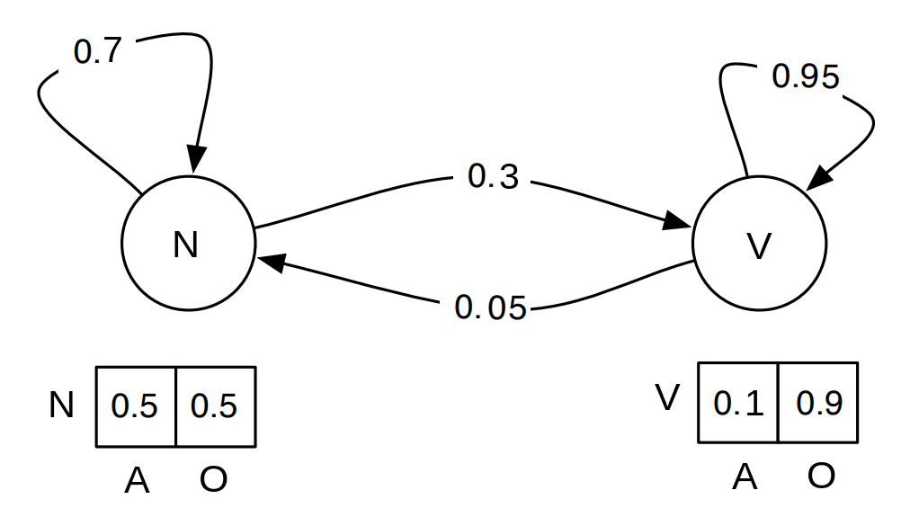
Example of HMM with Viterbi

Slide 27
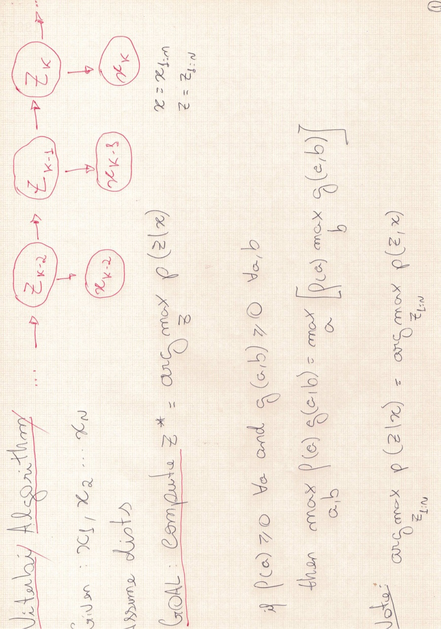

Slide 29
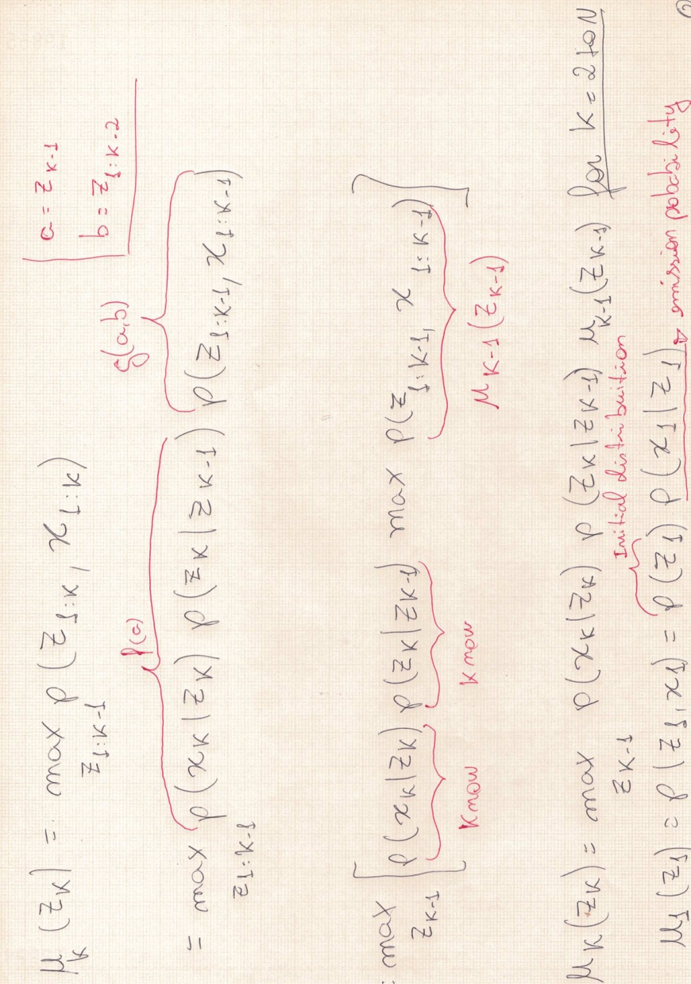

Slide 31
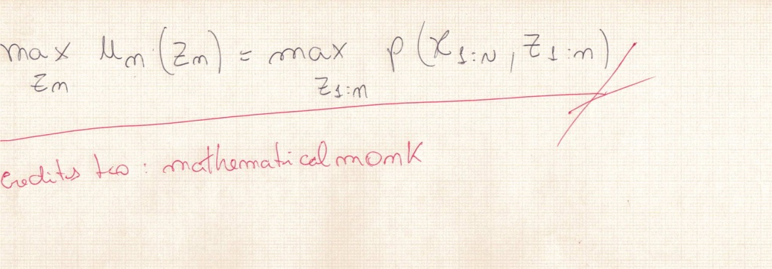

Slide 32
Example of HMM with Viterbi
Remember the moves:
A, O, O, O, A, A, O, A, A, O, O, O, A, O, O, A, A, O, O, O
By Viterbi we have:
N, N, N, N, N, N, N, N, N, V, V, V, V, V, V, V, V, V, V, V
As the most likely sequence of coins thrown

Slide 33
R code generation
Codes will be displayed in Rstudio.
Doubts? See:
github.com/gbazo/music

Slide 34
Python music generation
Codes will be displayed in Jupyter Notebook.
Doubts? See:
github.com/gbazo/music

Slide 35
music21 library
Music21 is a set of tools for helping students and others answer questions about music
quickly and simply.
In the example shown here this library is essential for music composition, giving life
to the sound created by the mathematical model, here all characteristics are attributed,
such as notes, time and finally the creation of audio in MIDI format.
Music21 is developed by the School of Humanities, Arts and Social Sciences at M.I.T.

Slide 36
MIDI
Short for Musical Instrument Digital Interface, is a technical standard that describes
a communications protocol, digital interface and electrical connectors that connect
a wide variety of musical instruments, computers and related.
MIDI carries event messages, data that specify the instrument for music, including a
note’s notation, pitch, velocity, vibrato, stereo and clock signals.

Slide 37
Music playback
The final sound will be saved in your personal folder, in my case:
/home/gabriel/
Differences can be found according OS settings.
To play MIDI on Linux a plugin may be required, if so, run on your terminal:
sudo apt-get install gstreamer1.0-plugins-bad gstreamer1.0-plugins-ugly
* for Debian based OS only

Slide 38
Final thanks
The realization of this project was possible given the multidisciplinary offered by the
postgraduate courses. The field of music study is widely used for mathematical and
computational applications, with projects in major research centers around the world.
You have to believe that dots will somehow connect in your future.
Steve Jobs

Slide 39
References
References, additional information and the codes used in this lecture can be found on
github.
github.com/gbazo/music
Questions and suggestions I am available through my email.
gabrielbazo@usp.br
This lecture is free to use as a way of generating and sharing knowledge. No copyright required.

